Slide 1
GNN
Deep approach to better together
Sandeep Polisetty, Hui Guan

Slide 2
Outline
Basic GNN Training
Basic GNN Inference
Challenges
Solutions
Evaluations
Future tasks

Slide 3
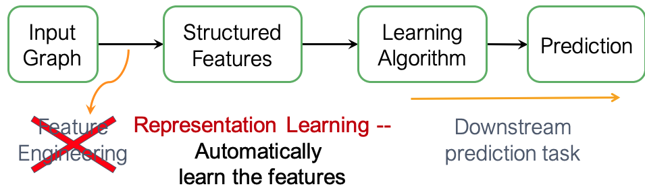
Q1: How to combine text and context?
Shallow Encoding
DeepWalk
Node2vec
ProNE
Deep Encoding
GNN

Slide 4
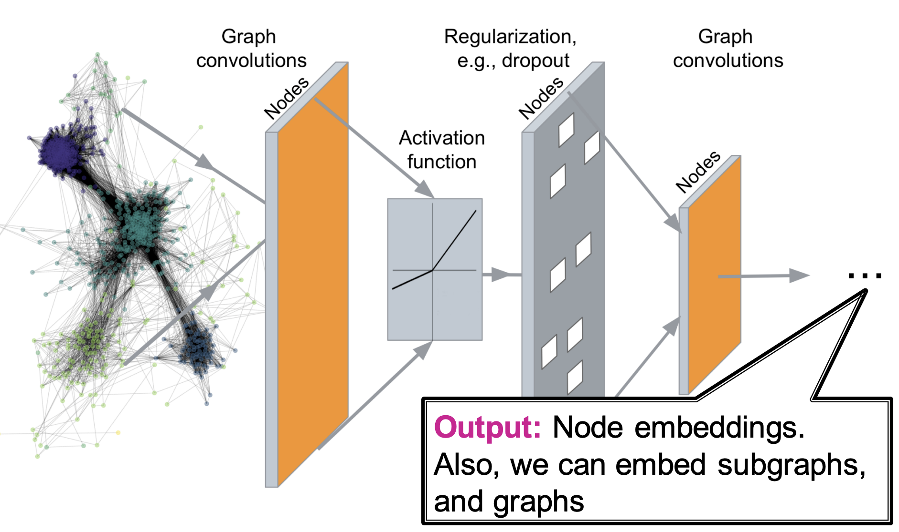
Approach #2: Deep Encoding
Encoder is GNN
Citation Graph
Node Features (Text)
GNN Encoder
Combined Features (Context + Text)

Slide 5
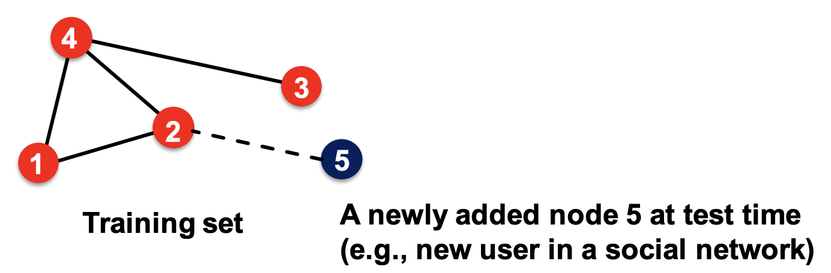
How to use the GNN on a new paper?
Induced graph
of node 5
Node features of the induced graph
a new paper added as node 5
GNN Encoder
Small updates can be handled by inference only.
No training needed.
Combined Feature of node 5
Combined features for nodes 1-4
MLP
Score (i, j)

Slide 6
Challenges with task and dataset
The large size of feature information which no GPU can handle.
Large number of training edges which by itself is 14 GB.
Irregularity of information available per node. Node embedding are used in representation learning in the absence of node features. However, combining trainable parameters with untrainable features complicates gradient propagation.
Inductive nature of predictions, where a large set of both potential query papers and result papers are not seen during training time.

Slide 7
Solutions
Training edges is over 20GB. Partition the graph using year a paper was published and construct an induced graph consisting of the papers cited by it. These snapshot graphs preserve graph characteristics such average degree. Further they provide fault tolerance, incremental trainability and parallelizability.
Irregularity of information flow. We use special embedding value to indicate MISSING values. We use a combination of concat and shuffle which are both differentiable operators to not compromise gradient flow.
Feature vector that does not fit in one GPU: Use UVA to allow the GPU kernels to access CPU RAM

Slide 8
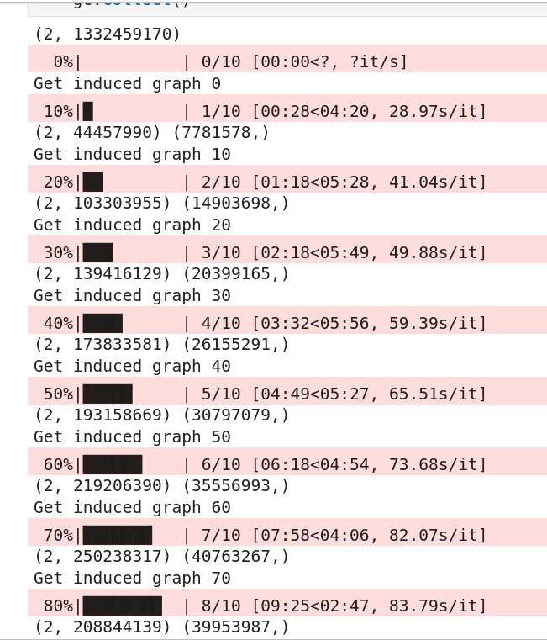
Partition Heuristic
Partition graph:
Bucket paper by year
All the papers it cites.
Graph characteristics such as
1.average degree are preserved
2.Other heuristics such as percentage of empty papers.

Slide 9
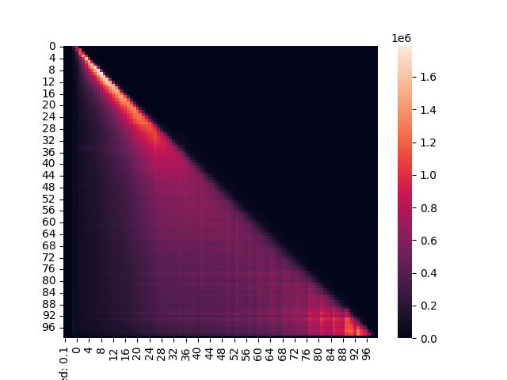
Graph Partitioning for training by year
Partitioning graph into bins and training one bin at a time, increases fault tolerance.

Slide 10
Challenge 2: Irregular information. Incomplete nodes are not contiguous. Every operator in this graph is differentiable.
Nodes W Features
Collected Features
Features
Graph Sample with
Reqd. input nodes.
Feat || Embedding
Nodes Without Feat
Broadcasted
Embedding
Shuffle in order of input
EMPTY embedding

Slide 11
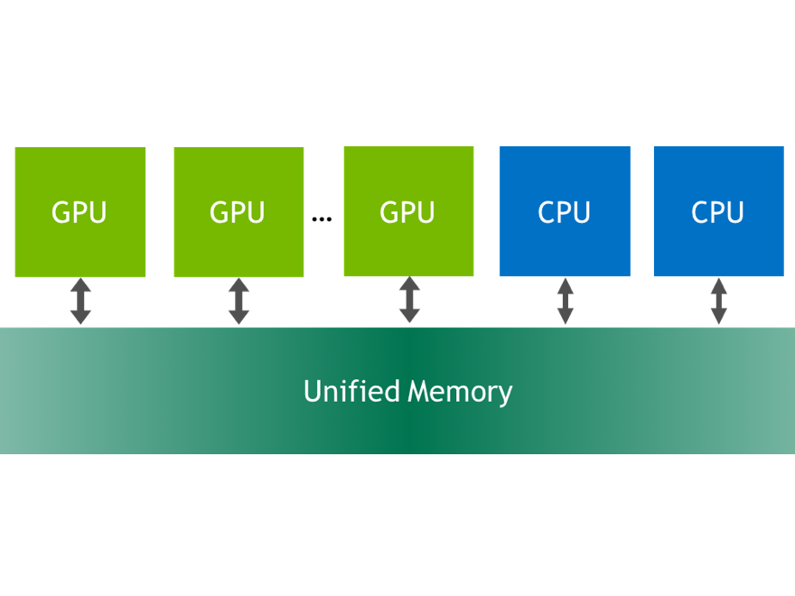
Large Feature vector which does’nt fit into memory.

Slide 12
Evaluate performance 2 X 2 - dimensions
Inductive: Predict links in an updated training graph containing newly added edges
Transductive: Identify missing links of training graph.
With text and context
With context alone
 | Inductive | Transductive
With Text | XX | XX
Without Text | XX | XX

Slide 13
Future Work
Inference with models from various bin ranges.
Additional hetero-signals
Using citing sentences

